Slide 1
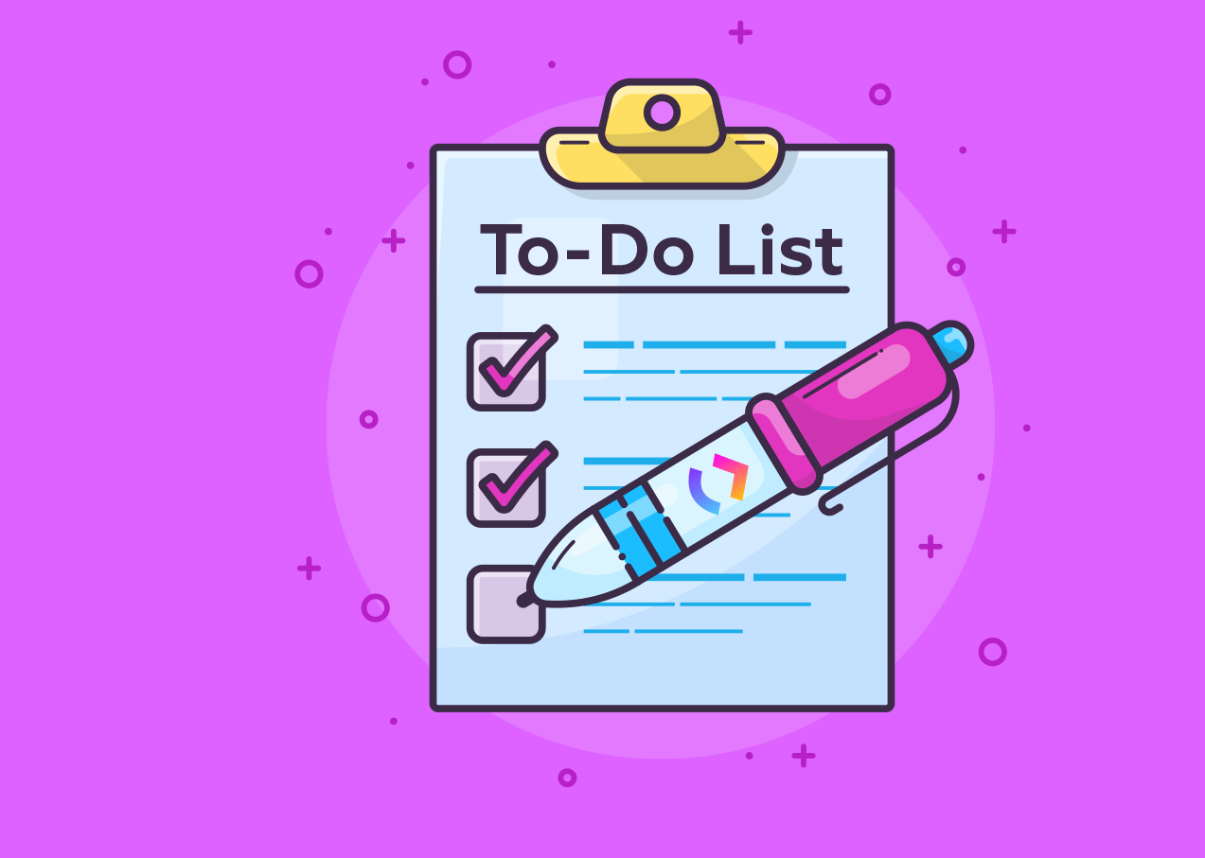
Todo list

Slide 2



I
Objective
To make a list of day to day goal and track the Activity.
To mark Activity whether is Completed or Not Completed.
Introduction
Nadigama Rohith
Sarth Sinha
R Dinesh

Slide 3
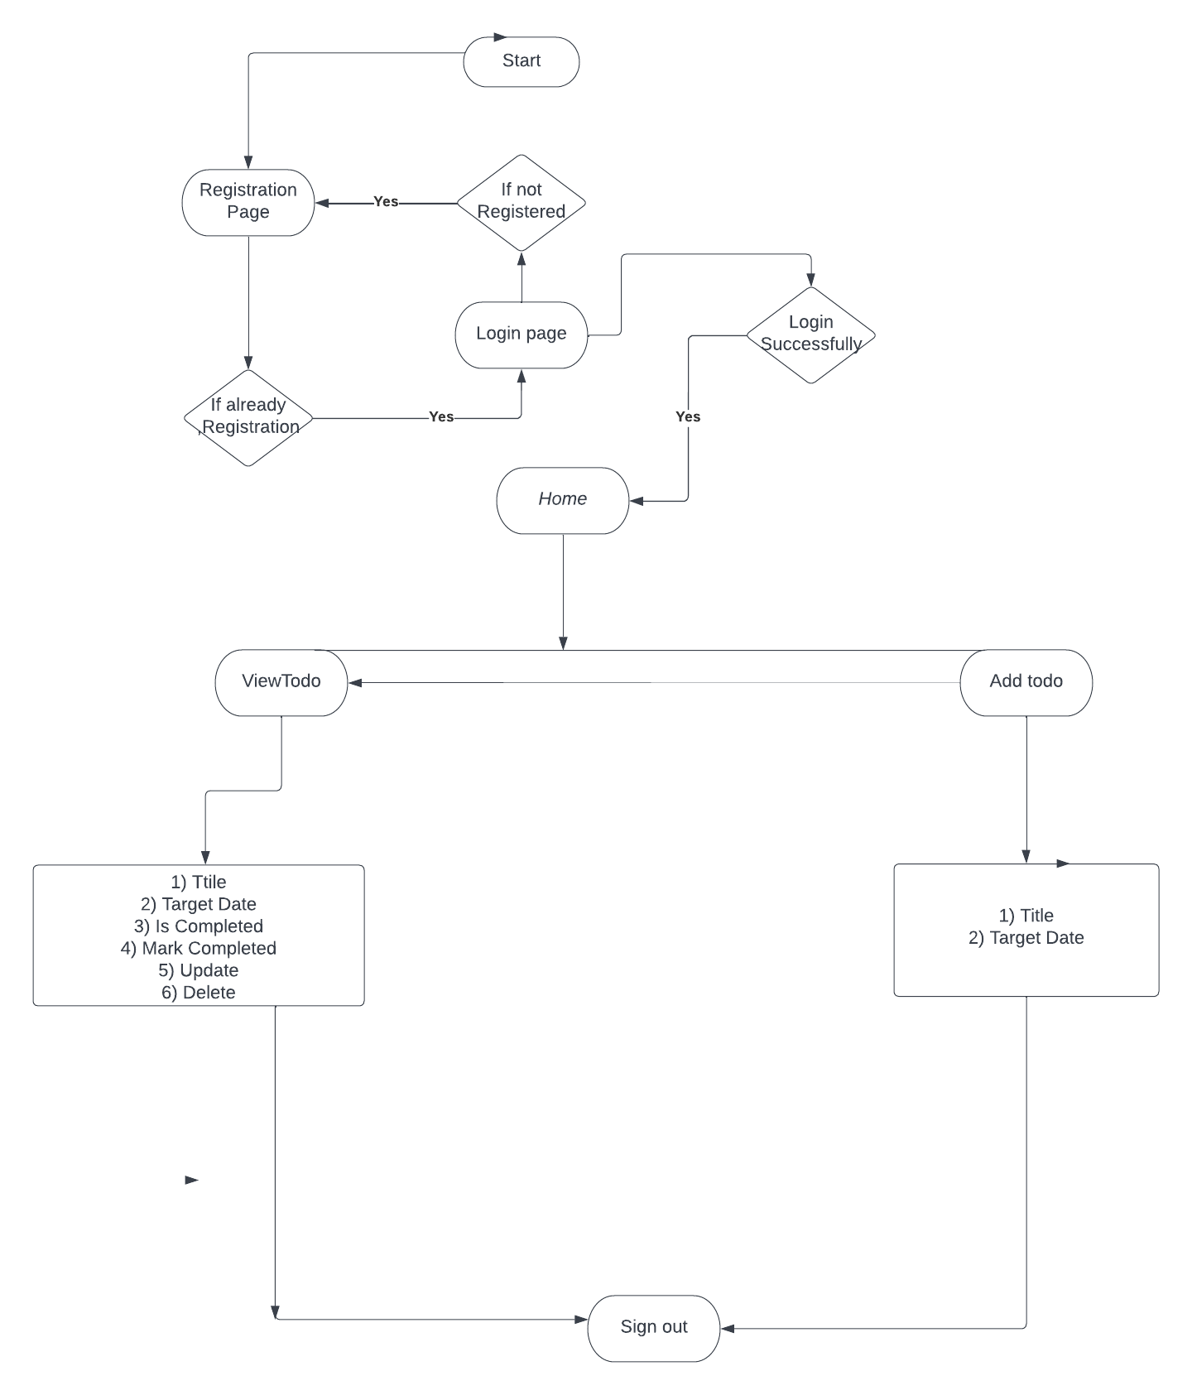
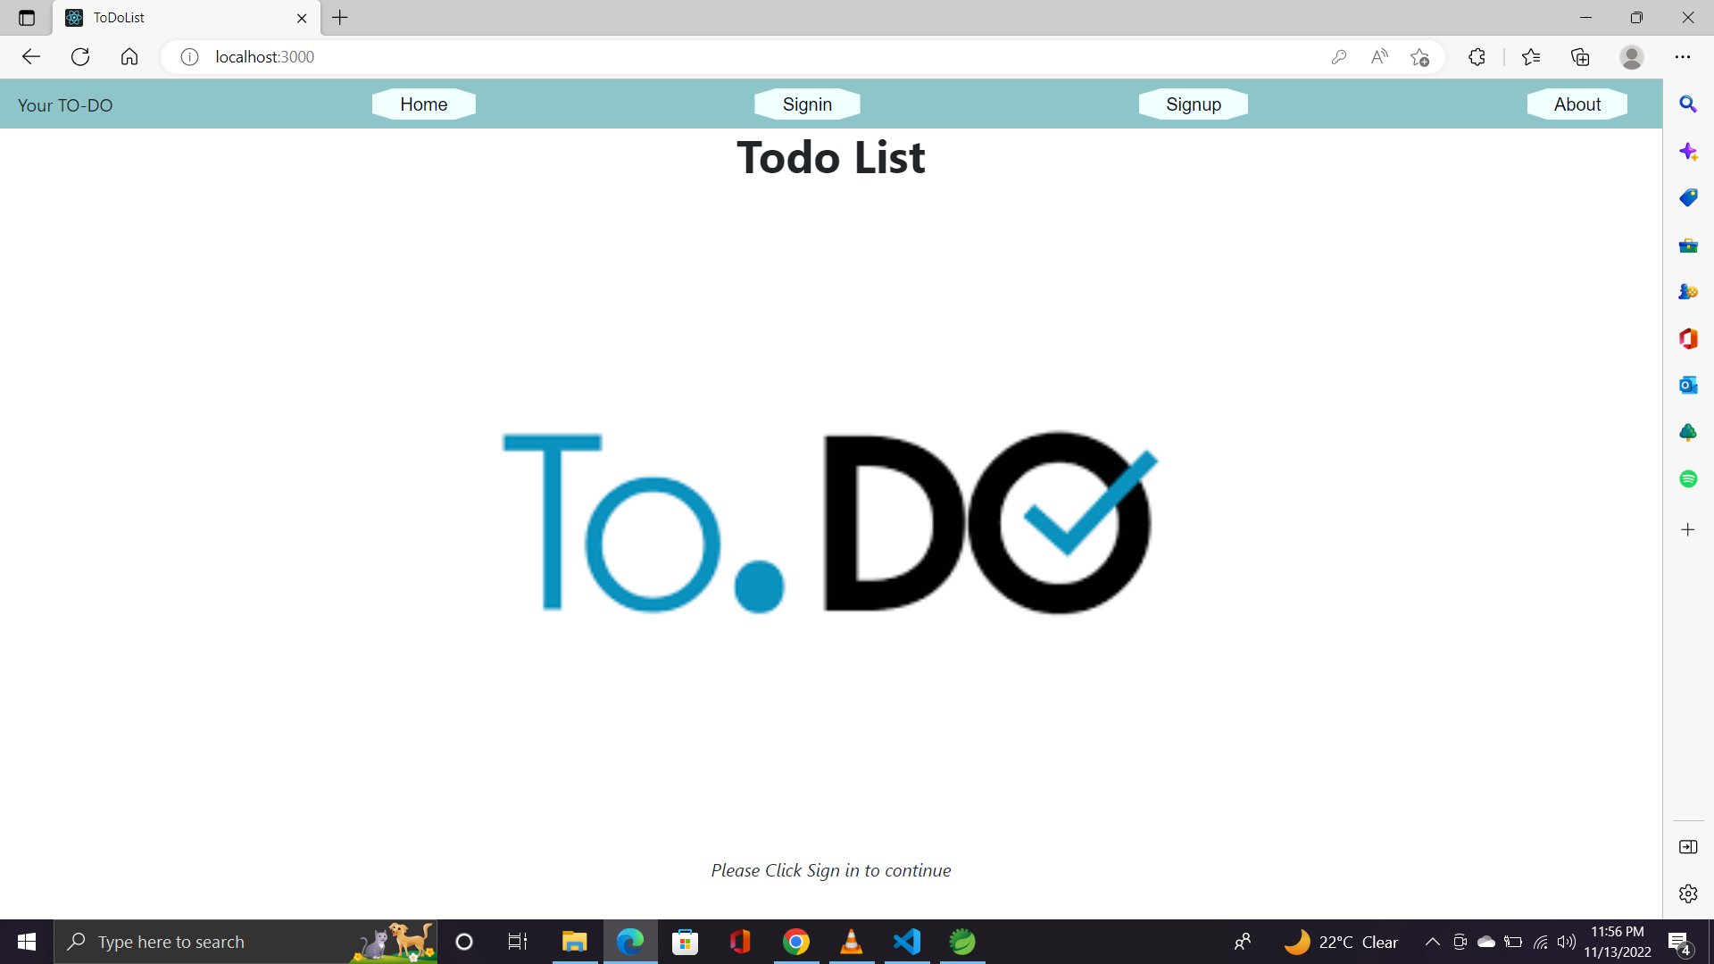
Presentation layer
Home- It is the first Page When User is going to Access.
Sign In- Here user has to log in by giving username and password.
Sign Up- Here user if not registered had to registered by giving username and password.
About- Says about the team.

Slide 4

Business Layer
Firstly we are defining class like - authentication Manager; password Encoder; Jwt Token Generator ; user Repository ; user Service;
then authentication manager comes to map sign in and sign up using post method, swagger helps in taking mapping sign in and sign up request then
Password encoder is used to encode secret key and generate token then token is generated and that token is used to validate username and password, It also used to check if token is null and if it is the message will be shown expired.
Along with password should be 8 characters as well as login page timeout should not be not more that 1 hour otherwise it will show expired or not found error message.
and at last after validating token in login swagger who just acts like a postman come under play to navigate through pages by giving address of the page to it.

Slide 5
Data Layer
In Data layer we are using Sequel Database (MySql).
We will create a database then connecting to backend, by this tables is generated.
In that table we are getting all the add-ed up todos of each user.
If the todo is completed then it will show up by Encrypted 01 and if not it will show by Encrypted 00 digit.

Slide 6

Boundary conditions
Password should be 8 digit length.
Username ,password should not be null
The date should be in the manner of DD-MM YYYY hh:mm:ss.
Token Should not be null.
The login page will expired after 3600000 ms.

Slide 7

Technologies Used
Spring Tool Suite(version :4.16.0)-It is platform that is used to implement backend of a project.
MYSQL-It is used to store data.(version : 8.0)
Visual Studio Code-It’s a I.D.E used to implement Reactjs ,Henceforth running our Frontend.(version :1.73.0)
Hibernate - Hibernate is a Java framework that simplifies the development of Java application to interact with the database .It is an open source, lightweight, ORM (Object Relational Mapping) tool. (version: JPA(2.2))
Swagger-Swagger helps users build, document, test and consume RESTful web services
Tomcat- Tomcat allows the users to run Servlet and JAVA Server Pages that are based on the web-applications.(Version: 9.0).

Slide 8

Features
We can increase the number of pages according to the user requirement of how many to-do to be added and we can also mark complete the activity if it's done.
We can also delete or update the Activity in TODO list.

Slide 9

Features to be Added
Notification – We are working to add a feature of user crossing the deadline of to -do activity then a gentle remainder/pop up message should be given to the user.

Slide 10
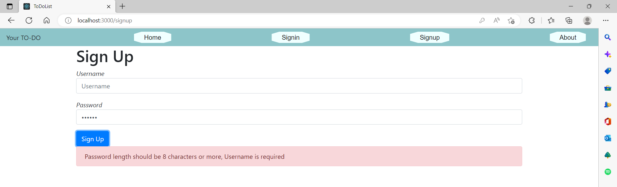
Testing of the code
The username and password should not be null and password should be at least Eight Characters.

Slide 11

Lessons Learnt
We developed team work while working on frontend and backend of the project each member has contributed their work in this project.
We faced problems like Bad Request, Unauthorized,Forbidden,Not Found error and solved them by Exception Handling.

Slide 12


